Slide 1
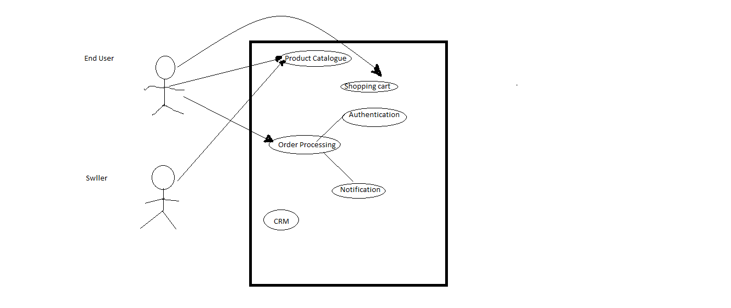
Payment
Billing
Shipping
Customer

